Slide 1

Predicting Air bnb prices in London
There is considerable empirical research on the effect of short-term rental led gentrification on the renting market, housing stock and demographical make-up of city centres. In spite of its considerable cons, AirBnB market is an efficient market with high volumes of interaction and a competitive pricing model.
For this project, we try to predict price per guest for listings in the London market.

Slide 2
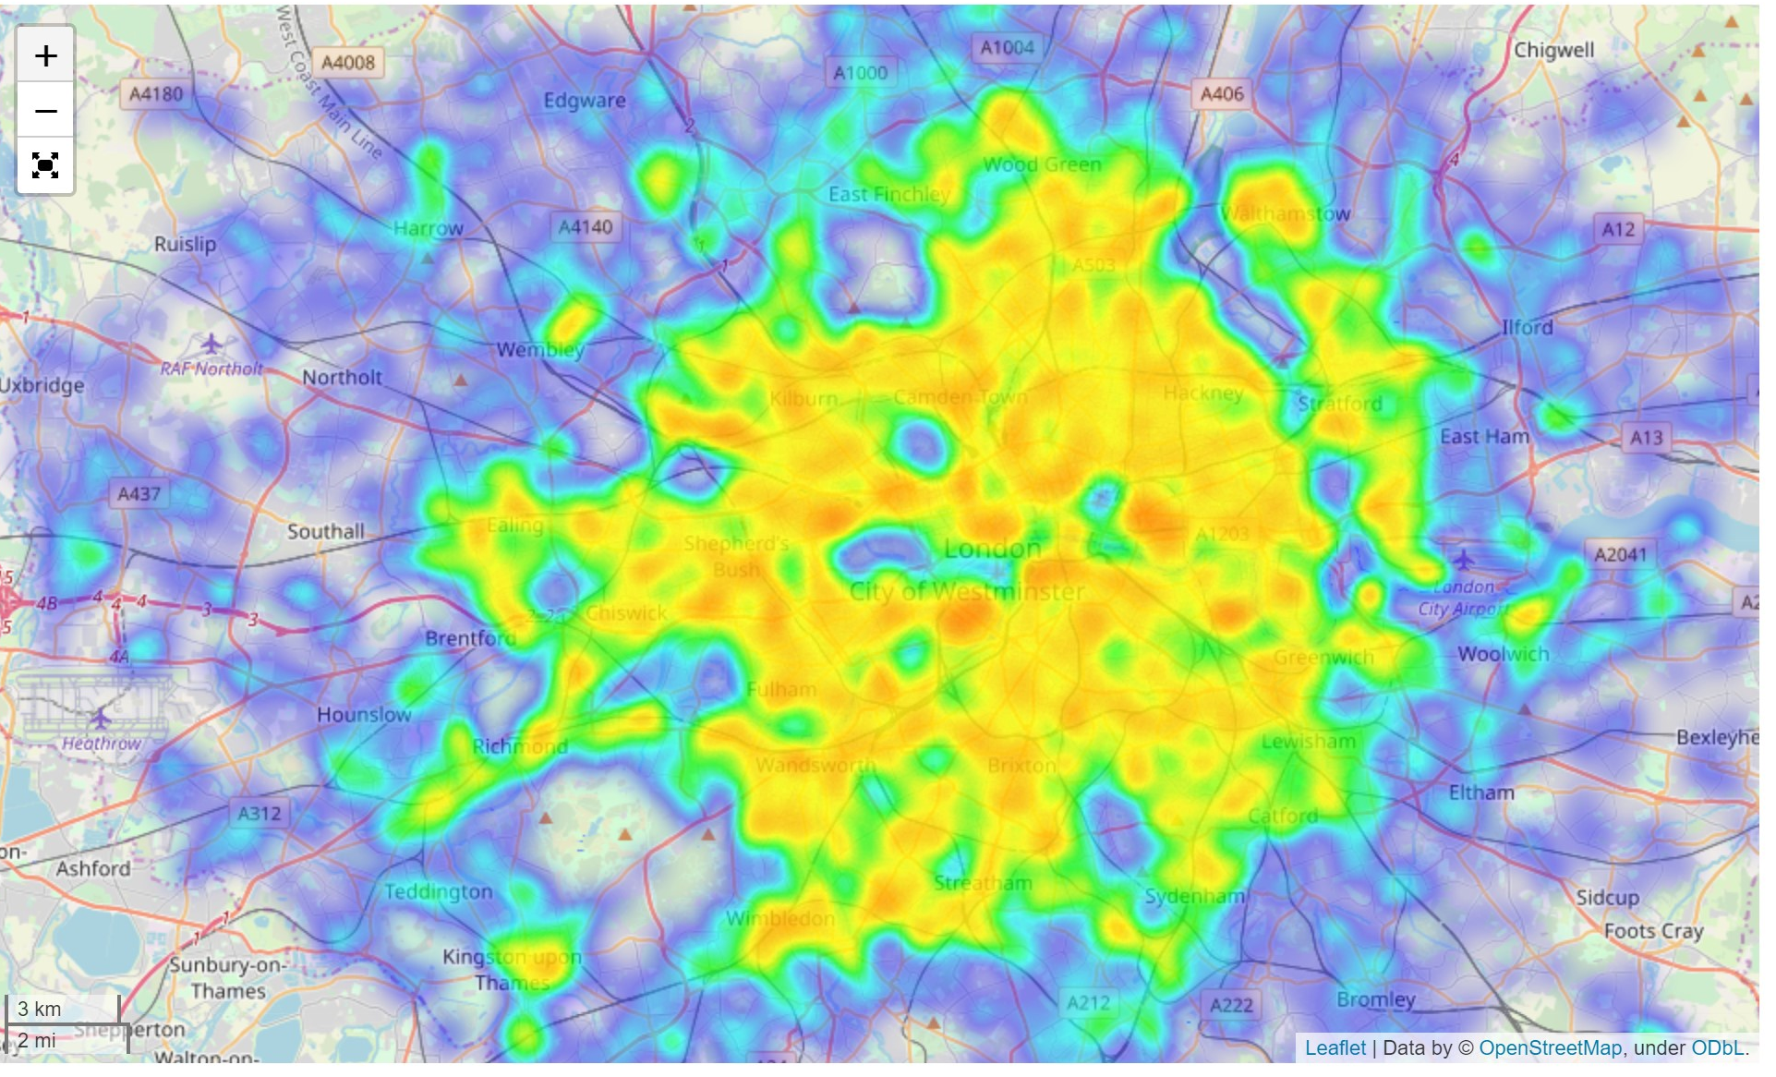
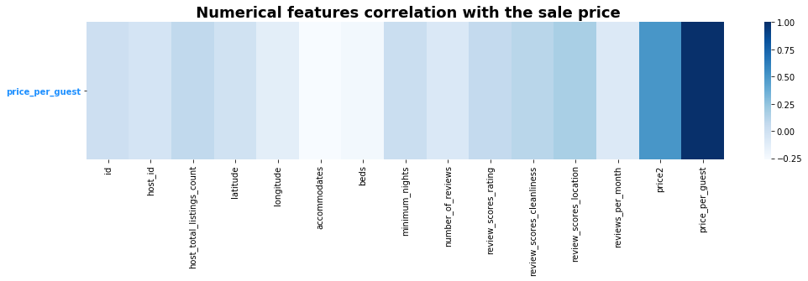
The Data
Insideairbnb.com
80000+ row entries
22+ Column Items including Price
Numerical: Mix of variables like beds, number of reviews, review score for cleanliness etc.
Categorical: Mix of variables like whether host_is_superhost, Property Type, Bed Type, London Zone
Text: Summary provided by host, neighbourhood overview and name strapline of listing.

Slide 3
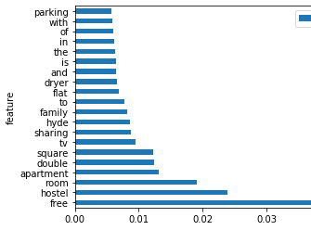
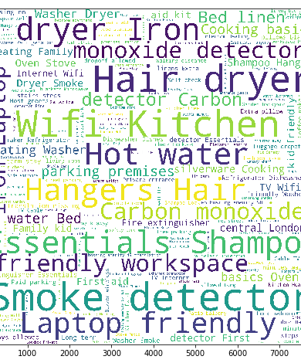
Transformations to the Data
Target variable with positive skew and large kurtosis: corrected by log transform.
One hot encoding the categorical variables – this helped increase the pool of variables and model complexity.
TF-IDF Vectorization: String Concat the text variables and perform a uniqueness model

Slide 4
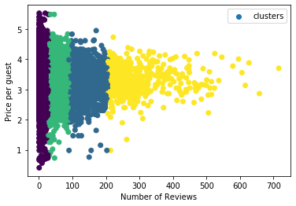
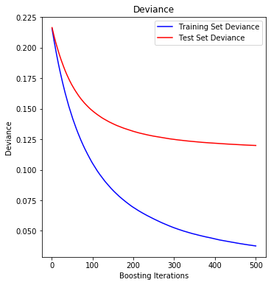
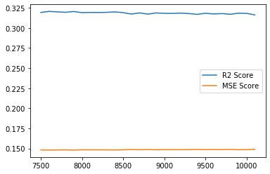
Methodology
Try to find the best “fit” with R2_score as a metric of success
Unsupervised Learning helped create additional feature to introduce additional complexity
Started with Lasso Linear Regression
DecisionTrees and RandomForests boosted the metric due to the non-normal distribution of the underlying.
GradientBoosting along with parameter tuning helped bring up the R2_score

Slide 5
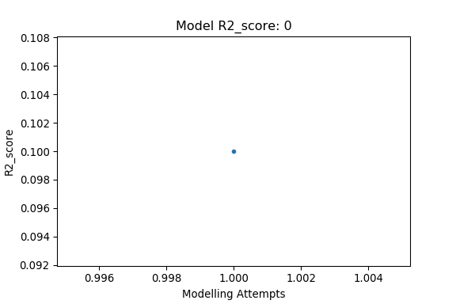
Final Takeaways
Journey in model development and feature expansion. The size of the marker represents number of features.
The model has limited accuracy with only 0.45 R2 score.
This however was a journey starting from the valley of despair in 0.1/
Proposed next steps: Join using reviews file and conduct sentiment analysis.
Introduce date based variables to see the effect of near-dated vs distant bookings.
Build out the Pricing Tool
Tune model to increase accuracy.
Final R2_score : 0.45

Slide 6
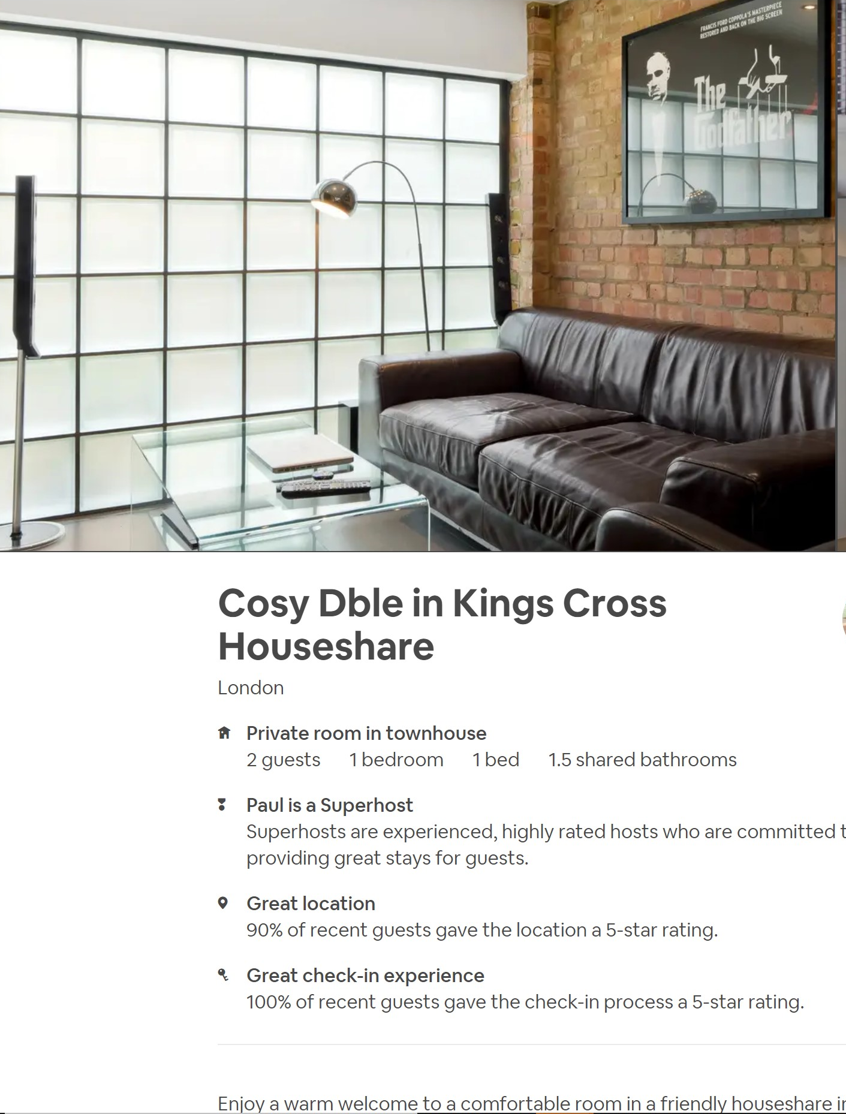
Let’s see the model in action
Let’s pick a random AirBnB listing from London, webscrape it and build out our model.

